Slide 1
Chapter 17
Swing Fundamentals
Copyright © 2013 by The McGraw-Hill Companies, Inc. All rights reserved.

Slide 2
Swing Fundamentals
Swing is a collection of classes and interfaces that offer a rich set of visual components.
Swing components are lightweight—they are written entirely in Java.
As such, they can have a variety of look-and-feels.
Copyright © 2013 by The McGraw-Hill Companies, Inc. All rights reserved.

Slide 3
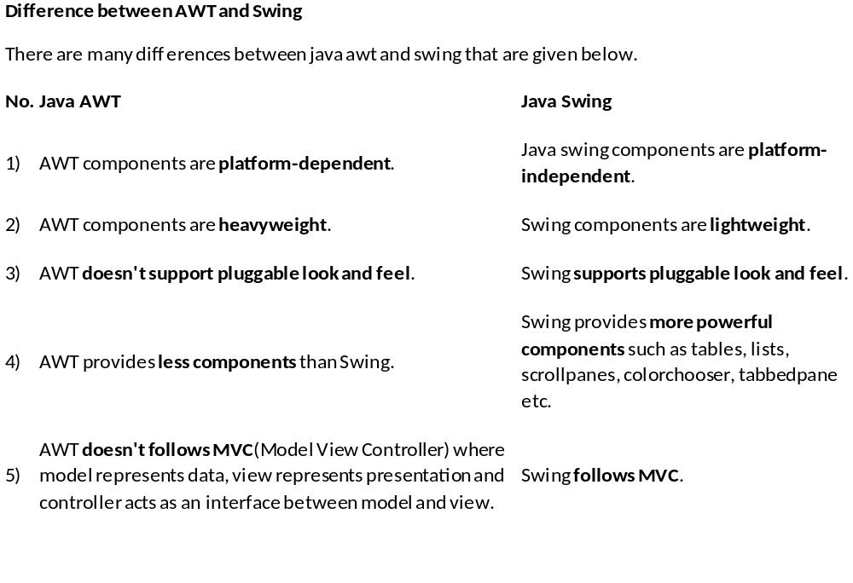

Slide 4
Swing components are lightweight:
This means that they are written entirely in Java and do not map directly to platform-specific peers.
lightweight components are more efficient and more flexible.
Swing components provide pluggable look and feel:
because lightweight components do not translate into native peers, the look and feel of each component is determined by Swing, not by the underlying operating system.

Slide 5
Model-View-Controller (MVC)
model—corresponds to state information of a component
For example, in a check box model contains a field indicating checked/unchecked.
view—determines how the component is displayed on the screen
controller—determines how the component reacts to the user
For example when user clicks on check box , the controller reacts by changing the model to reflect the user choice
Swing uses a modified version of MVC that combines the view and controller.
Copyright © 2013 by The McGraw-Hill Companies, Inc. All rights reserved.

Slide 6
Components
Swing consists of two key items: components and containers.
The JComponent class is the superclass of all but four Swing components.
All Swing components are in the javax.swing package.
There are currently 46 Swing components, including JButton, JDialog, JCheckBox, JMenu, and JMenuItem.
Copyright © 2013 by The McGraw-Hill Companies, Inc. All rights reserved.

Slide 7
Containers
Top-level containers in Swing: JFrame, JApplet, JWindow, JDialog.
These do not inherit from JComponent.
Top-level containers cannot be contained in another container.
Top-level containers contain several components called panes.
The content pane holds the components the user interacts with.
Copyright © 2013 by The McGraw-Hill Companies, Inc. All rights reserved.

Slide 8
Layout Managers
Layout managers control the position of components within a container.
Layout managers implement the LayoutManager interface.
Two of the layout managers are:
  FlowLayout—A simple layout that positions components left-to-right, top-to-bottom.
  BorderLayout—Positions components within the center or on the borders of the container. This is the default layout for a content pane.
Copyright © 2013 by The McGraw-Hill Companies, Inc. All rights reserved.

Slide 9
Simple Swing Demo
import javax.swing.*;
class SwingDemo {
SwingDemo() {
JFrame jfrm = new JFrame("A Simple Swing App");
jfrm.setSize(275, 100);
jfrm.setDefaultCloseOperation(JFrame.EXIT_ON_CLOSE);
JLabel jlab = new JLabel(" Swing: the Java GUI.");
jfrm.add(jlab);
jfrm.setVisible(true);
}
public static void main(String[] args) {
SwingUtilities.invokeLater(new Runnable() {
public void run() { new SwingDemo(); }
});
}
}
Copyright © 2013 by The McGraw-Hill Companies, Inc. All rights reserved.

Slide 10
Event Dispatching Thread
Swing applications are event driven.
Swing provides an event-dispatching thread to handle events, separate from the main thread.
All Swing GUI components must be created and updated on the event-dispatching thread.
In the SwingDemo class, the call to SwingUtilities.invokeLater( ) causes the Runnable code to be executed on the event-dispatching thread.
Copyright © 2013 by The McGraw-Hill Companies, Inc. All rights reserved.

Slide 11
Event Handling
Event handling is a large part of any Swing-based application.
Events are generated when, for example, the user clicks a button, types a key, or selects an item from a list.
In Swing, a source generates an event and sends it to one or more listeners.
Listeners just wait until they receive events, and then they process the events.
Copyright © 2013 by The McGraw-Hill Companies, Inc. All rights reserved.

Slide 12
Event Handling (continued)
This approach is called the delegation event model since the GUI element delegates the processing of the event to a separate object.
All listeners must register with the source if they wish to be notified of events.
Copyright © 2013 by The McGraw-Hill Companies, Inc. All rights reserved.

Slide 13
The Delegation Event Model
Defines standard and consistent mechanisms to generate and process events
A source generates an event and sends it to one or more listeners
The listener simply waits until it receives an event
Once received, the listener processes the event and then returns

Slide 14
The Delegation Event Model
The advantage of this design is that the application logic that processes events is cleanly separated from the user interface logic that generates those events
In the delegation event model, listeners must register with a source in order to receive an event notification

Slide 15
Event Sources
Event sources have methods of the form:
  public void addTypeListener(TypeListener el)
  public void removeTypeListener(TypeListener el)
These methods are called to add or remove listeners from the notification list.
Example:
JButton b = new JButton();
ActionListener el = new ActionListener(){ ... }
b.addActionListener(el);
Copyright © 2013 by The McGraw-Hill Companies, Inc. All rights reserved.

Slide 16
Event Listeners
Listeners are notified when events occur.
They have two requirements:
  They must register with a source.
  They must implement a method to receive and process the event.
The methods they implement are defined by interfaces.
The methods must quickly process the event and return or else use a separate thread, to avoid tying up the event-dispatching thread.
Copyright © 2013 by The McGraw-Hill Companies, Inc. All rights reserved.

Slide 17
Some Event Classes
Event Class | Description | Event Listener
ActionEvent | Generated when an action occurs within a control, such as when a button is pressed. | ActionListener
MouseEvent | Generated when the mouse is dragged, moved, clicked, pressed, or released; also generated when the mouse enters or exits a component. | MouseListener and MouseMotionListener
Copyright © 2013 by The McGraw-Hill Companies, Inc. All rights reserved.

Slide 18
Understanding Layout Managers
Each Container object has a layout manager associated with it.
The layout manager is set by the setLayout( ) method
void setLayout(LayoutManager layoutObj)
layoutObj → A reference to the desired layout manager
→pass null for layoutObj If you wish to disable the layout manager.

Slide 19
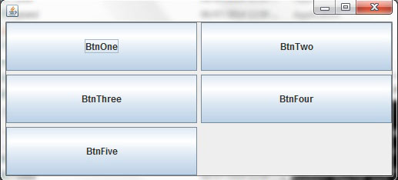
The GridLayout manager is one that divides a container into a set of cells spread on a rectangular grid , so that they all possess the same dimension.
We can split a container into rows and columns according to their need . The components are arranged in the order in which they appear, with inserted in the grid from left to right and top to bottom.
We can also specify horizontal and vertical space between columns

Slide 20
import javax.swing.*;
import java.awt.*;
public class JavaExampleGridLayout extends JFrame
{
private JButton BtnOne = new JButton("BtnOne");
private JButton BtnTwo = new JButton("BtnTwo");
private JButton BtnThree = new JButton("BtnThree");
private JButton BtnFour = new JButton("BtnFour");
private JButton BtnFive = new JButton("BtnFive");
private GridLayout layout = new GridLayout(3, 2, 5, 5);
public JavaExampleGridLayout()
{
setSize(200, 200);
setLayout(layout);
add(BtnOne);
add(BtnTwo);
add(BtnThree);
add(BtnFour);
add(BtnFive);
setVisible(true);
}
public static void main(String[] args)
{
JavaExampleGridLayout frame = new JavaExampleGridLayout();
}
}

Slide 21
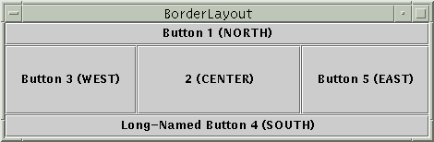
BorderLayout
public BorderLayout()
divides container into five regions: NORTH, SOUTH, WEST, EAST, CENTER
NORTH and SOUTH regions expand to fill region horizontally, and use preferred size vertically
WEST and EAST regions expand to fill region vertically, and use preferred size horizontally
CENTER uses all space not occupied by others
Container panel = new JPanel(new BorderLayout());
panel.add(new JButton("Button 1 (NORTH)", BorderLayout.NORTH);

Slide 22
import javax.swing.*;
import java.awt.*;
public class BorderLayoutJavaExample extends JFrame
{
private JButton NrthBtn = new JButton("North Button");
private JButton SthBtn = new JButton("South Button");
private JButton EstBtn = new JButton("East Button");
private JButton WstBtn = new JButton("West Button");
private JButton CntrBtn = new JButton("Center Button");
public BorderLayoutJavaExample()
{
setLayout(new BorderLayout());
add(NrthBtn,BorderLayout.NORTH);
add(SthBtn, BorderLayout.SOUTH);
add(EstBtn, BorderLayout.EAST);
add(WstBtn, BorderLayout.WEST);
add(CntrBtn, BorderLayout.CENTER);
setVisible(true);
setSize(400, 150);
}
public static void main(String[] args)
{
BorderLayoutJavaExample frame = new BorderLayoutJavaExample();
}
}

Slide 23
FlowLayout
The FlowLayout is the simplest manager.
The components are arranged from left to right in the order in which they appear, i.e., in the order they are added.
When there is no more space on a line, another line is created, resembling a text editor. This process is automatically done according to the container size.

Slide 24
import javax.swing.*;
import java.awt.event.*;
public class JFrameClickEventExample extends JFrame implements MouseListener
{
public JLabel label;
public static void main(String args[])
{
new JFrameClickEventExample();
}
JFrameClickEventExample()
{
setSize(500, 400);
setTitle("Java Swing - JFrame Detect Mouse Events");
label = new JLabel("No Mouse Event Captured", JLabel.CENTER);
add(label);
addMouseListener(this);
setVisible(true);
}

Slide 25
//Overridden Methods from MouseListener Interface
//These methods are called automatically when corresponding mouse
//event occurs
public void mousePressed(MouseEvent e)
{
label.setText("Mouse Pressed");
}
public void mouseReleased(MouseEvent e)
{
label.setText("Mouse Released");
}
public void mouseEntered(MouseEvent e)
{
label.setText("Mouse Entered");
}
public void mouseExited(MouseEvent e)
{
label.setText("Mouse Exited");
}
public void mouseClicked(MouseEvent e)
{
label.setText("Mouse Clicked");
}}

Slide 26
Event handling for Frame Window
import javax.swing.*;
import java.awt.*;
import java.awt.event.*;
public class JavaExampleFlowLayout extends JFrame implements ActionListener
{
private JButton LBtn = new JButton("Left Button");
private JButton RBtn = new JButton("Right Button");
private Container cntnr = getContentPane();
private FlowLayout layout = new FlowLayout();
public JavaExampleFlowLayout()
{
cntnr.setLayout(layout);
cntnr.add(LBtn);
cntnr.add(RBtn);
LBtn.addActionListener(this);
RBtn.addActionListener(this);
setSize(500, 100);
setVisible(true);
}

Slide 27
public void actionPerformed(ActionEvent evnt)
{
Object src = evnt.getSource();
if(src == LBtn)
layout.setAlignment(FlowLayout.LEFT);
else
layout.setAlignment(FlowLayout.RIGHT);
}
public static void main(String[] args)
{
JavaExampleFlowLayout frame = new JavaExampleFlowLayout();
}
}

Slide 28
Adapter Classes
Adapter classes provide empty implementations of event listener interface methods.
You can extend one and implement only those methods in which you are interested.
Sample adapter classes:
Adapter Class | Implements
ActionAdapter | ActionListener
MouseAdapter | MouseListener
MouseMotionAdapter | MouseMotionListener
Copyright © 2013 by The McGraw-Hill Companies, Inc. All rights reserved.

Slide 29
Adapter classes are useful when you want to receive and process only some of the events that are handled by a particular event listener interface.
You can define a new class to act as an event listener by extending one of the adapter classes and implementing only those events in which you are interested.
For example, the MouseMotionAdapter class has two methods, mouseDragged( ) and mouseMoved( ), which are the methods defined by the MouseMotionListener interface.
If you were interested in only mouse drag events, then you could simply extend MouseMotionAdapter and override mouseDragged( ). The empty implementation of mouseMoved( ) would handle the mouse motion events for you.

Slide 30
import java.awt.*;
import java.awt.event.*;
public class FrameMouseAdapterExample extends Frame
{
public FrameMouseAdapterExample()
{
// adding MouseAdapter to frame
PleaseHandle ph = new PleaseHandle();
addMouseListener(ph);
setSize(300, 300);
setVisible(true);
}
public static void main(String args[])
{
new FrameMouseAdapterExample();
}}
class PleaseHandle extends MouseAdapter // second class
{
public void mouseClicked(MouseEvent e)
{
System.out.println("You clicked mouse at coordinates " + e.getX() + ", " + e.getY()); }}

Slide 31
Jlabel jlab;
private void makeGUI() {
setLayout(new FlowLayout()); // Set the applet to use flow layout.
jbtnAlpha = new JButton("Alpha"); // Make two buttons.
jbtnBeta = new JButton("Beta");
jbtnAlpha.addActionListener(new ActionListener() {// Add action listener for Alpha.
public void actionPerformed(ActionEvent le) {
jlab.setText("Alpha was pressed.");
}
});
// Add action listener for Beta.
jbtnBeta.addActionListener(new ActionListener() {
public void actionPerformed(ActionEvent le) {
jlab.setText("Beta was pressed.");
}
});

Slide 32
An anonymous inner class is one that is not assigned a name. Consider the applet shown in the following listing. As before, its goal is to display the string “Mouse Pressed” in the status bar of the applet viewer or browser when the mouse is pressed.
// Anonymous inner class demo.
import java.applet.*;
import java.awt.event.*;
/*
<applet code="AnonymousInnerClassDemo“ width=200 height=100>
</applet>
*/

Slide 33
public class AnonymousInnerClassDemo extends Applet {
public void init() {
addMouseListener(new MouseAdapter() {
public void mousePressed(MouseEvent me) {
showStatus("Mouse Pressed"); } }); } }
There is one top-level class in this program: AnonymousInnerClassDemo. The init( ) method calls the addMouseListener( ) method. Its argument is an expression that defines and instantiates an anonymous inner class

Slide 34
import javax.swing.*;
import java.awt.event.*;
import java.awt.*;
class AdapterExample extends JFrame
{
AdapterExample()
{
this.addMouseListener(new MouseAdapter(){ public void mouseClicked(MouseEvent e) { statusLabel.setText("Mouse Clicked: (" +e.getX()+", "+e.getY() +")"); } }); }
}

Slide 35
class AdapterClassJavaExample
{
public static void main(String [] args)
{
AdapterExample frame = new AdapterExample();
frame.setTitle("Adapter Class Java Example");
frame.setBounds(100,200,200,200);
frame.setVisible(true);
}
}
Event Adapter Class in Java Example

Slide 36
public class AnonymousInnerClassDemo extends Applet {
public void init() {
addMouseListener(new MouseAdapter() {
public void mousePressed(MouseEvent me) {
showStatus("Mouse Pressed");
}
});
}
}

Slide 39
Using a Push Button
A push button is an instance of JButton.
A push button generates an ActionEvent.
The associated listener interface is ActionListener, which has one method:
  public void actionPerformed(ActionEvent ae)
In summary, to handle a button press event,
  Create a class that implements ActionListener.
  Register the class with the JButton by calling the button's addActionListener( ) method.
Copyright © 2013 by The McGraw-Hill Companies, Inc. All rights reserved.

Slide 40
Using a Push Button (continued)
When the user presses the JButton, it generates an ActionEvent.
All registered listeners are notified; more precisely their actionPerformed( ) methods are called.
The ActionEvent is passed as the argument to the actionPerformed( ) method.
ActionEvent class has several methods to give you more information about the event.
Copyright © 2013 by The McGraw-Hill Companies, Inc. All rights reserved.

Slide 41
Push Button Example
class ButtonHandler implements ActionListener {
public void actionPerformed(ActionEvent ae) {
label.setText(ae.getActionCommand());
}
}
...
JButton button = new JButton("First");
ButtonHandler handler = new ButtonHandler();
button.addActionListener(handler);
...
// when the button is pushed, the word "First" is
// displayed as the text in a label.
Copyright © 2013 by The McGraw-Hill Companies, Inc. All rights reserved.

Slide 42
Introducing JTextFields
A JTextField control enables the user to enter a line of text.
If the user presses ENTER when inputting into a text field, an ActionEvent is generated.
Listeners must implement the ActionListener interface.
Copyright © 2013 by The McGraw-Hill Companies, Inc. All rights reserved.

Slide 43
Introducing JTextFields (continued)
One of its constructors:
  JTextField(int cols)
It creates a text field with the given width.
The JTextField class has methods for accessing the text that the field displays:
  void setText(String text)
  String getText( )
Copyright © 2013 by The McGraw-Hill Companies, Inc. All rights reserved.

Slide 44
JTextField Example
class TextFieldHandler implements ActionListener {
public void actionPerformed(ActionEvent ae) {
label.setText(ae.getActionCommand());
}
}
...
JTextField field = new JTextField(10);
TextFieldHandler handler = new TextFieldHandler();
field.addActionListener(handler);
...
// when ENTER is pressed, the contents of the text
// field are displayed in a label.
Copyright © 2013 by The McGraw-Hill Companies, Inc. All rights reserved.

Slide 45
Using Anonymous Inner Classes
Here are some ways to handle events:
  Have the class with the main method be the listener.
  Create a separate listener class.
  Use an anonymous inner class as the listener.
Example of the third way:
button.addActionListener(new ActionListener() {
public void actionPerformed(ActionEvent ae) {
label.setText(ae.getActionCommand());
}
});
Copyright © 2013 by The McGraw-Hill Companies, Inc. All rights reserved.

